Slide 1
Insight Into Apache ShardingSphere
SphereEx@Zhengqiang Duan

Slide 2
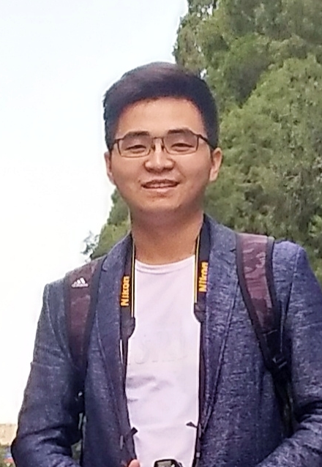


About me
Zhengqiang Duan 端正强
SphereEx Java Senior Software Engineer
Committer of Apache ShardingSphere
Love open source, currently focusing on the development of Apache ShardingSphere database middleware.

Slide 3
CONTENTS
目录
1
Introduction
2
Architecture
3
Features
4
Community

Slide 4
Introduction
01
简介

Slide 5
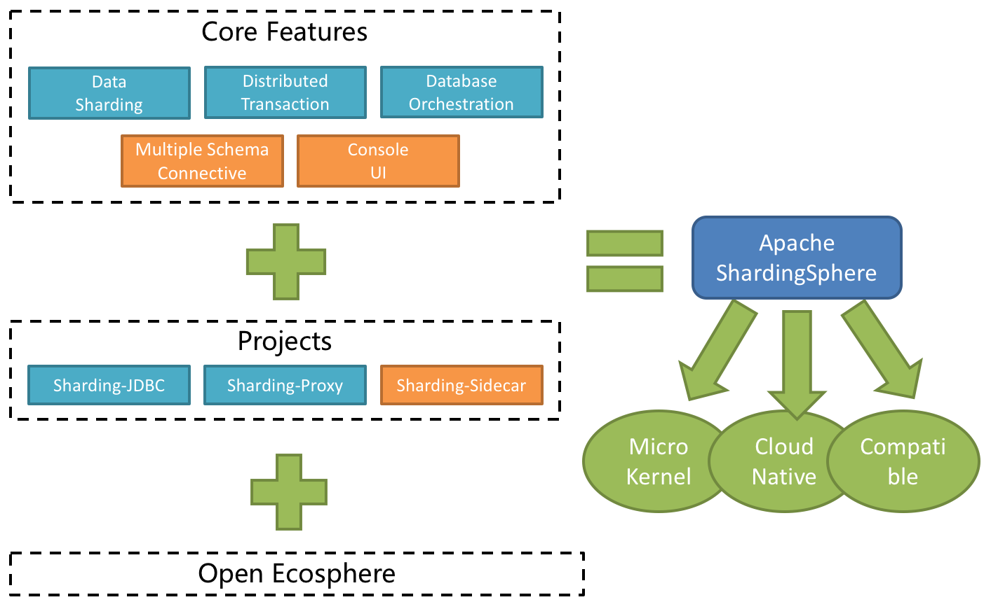
Introduction
Apache Top Level Project
Open-source distributed database ecosystem
Provide data sharding, distributed transaction and distributed governance functions
Support MySQL, Oracle, SQLServer, PostgreSQL and any SQL92 followed databases

Slide 6
Architecture
02
架构

Slide 7
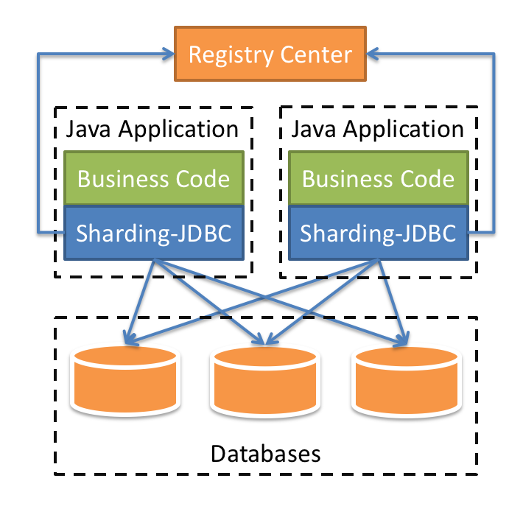
Architecture-Sharding-JBDC
Lightweight Java framework that provides extra service at Java JDBC layer.
Applicable in any ORM framework based on JDBC
Support any third-party database connection pool
Support any kind of JDBC standard database—— MySQL, Oracle, SQLServer, PostgreSQL and any SQL92 followed databases

Slide 8
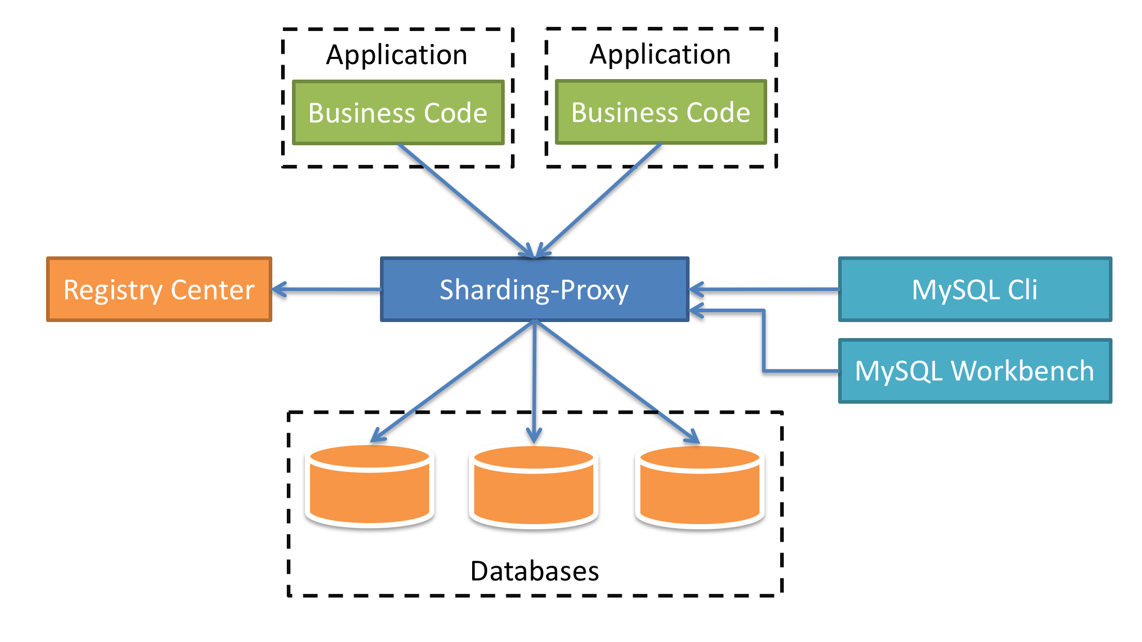
Architecture-Sharding-Proxy
Transparent to applications, it can be used directly as MySQL/PostgreSQL
Applicable to any kind of terminal that is compatible with MySQL and PostgreSQL protocol

Slide 9
Architecture-Compare
 | Sharding-JDBC | Sharding-Proxy
Database | Any | MySQL/PostgreSQL
Connections Count Cost | High | Low
Supported Languages | Java Only | Any
Performance | Low loss | Relatively High loss
Decentralization | Yes | No
Static Entry | No | Yes

Slide 10
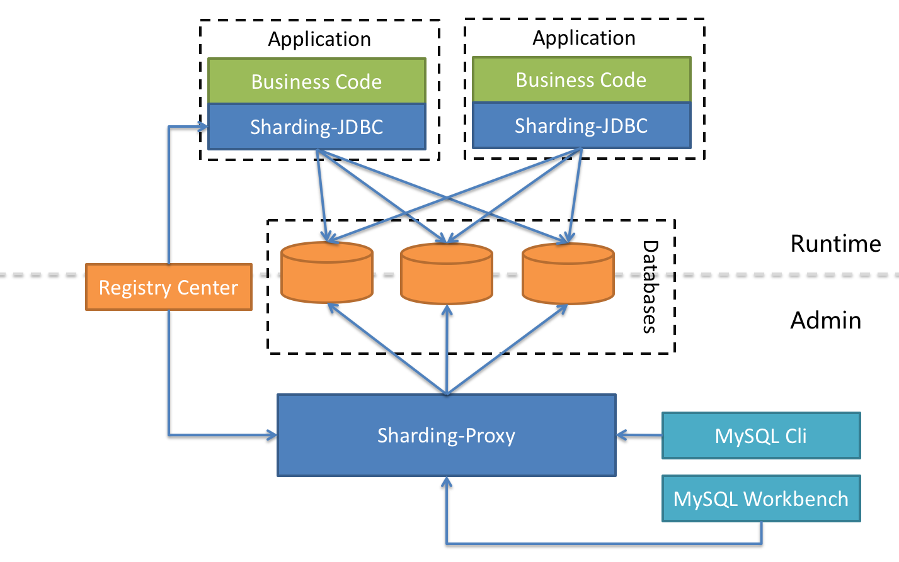
Architecture-Hybrid

Slide 11
Features
03
特性

Slide 12
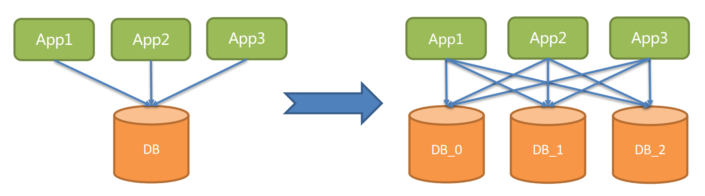
Features - Data sharding
Vertical Sharding

Slide 13
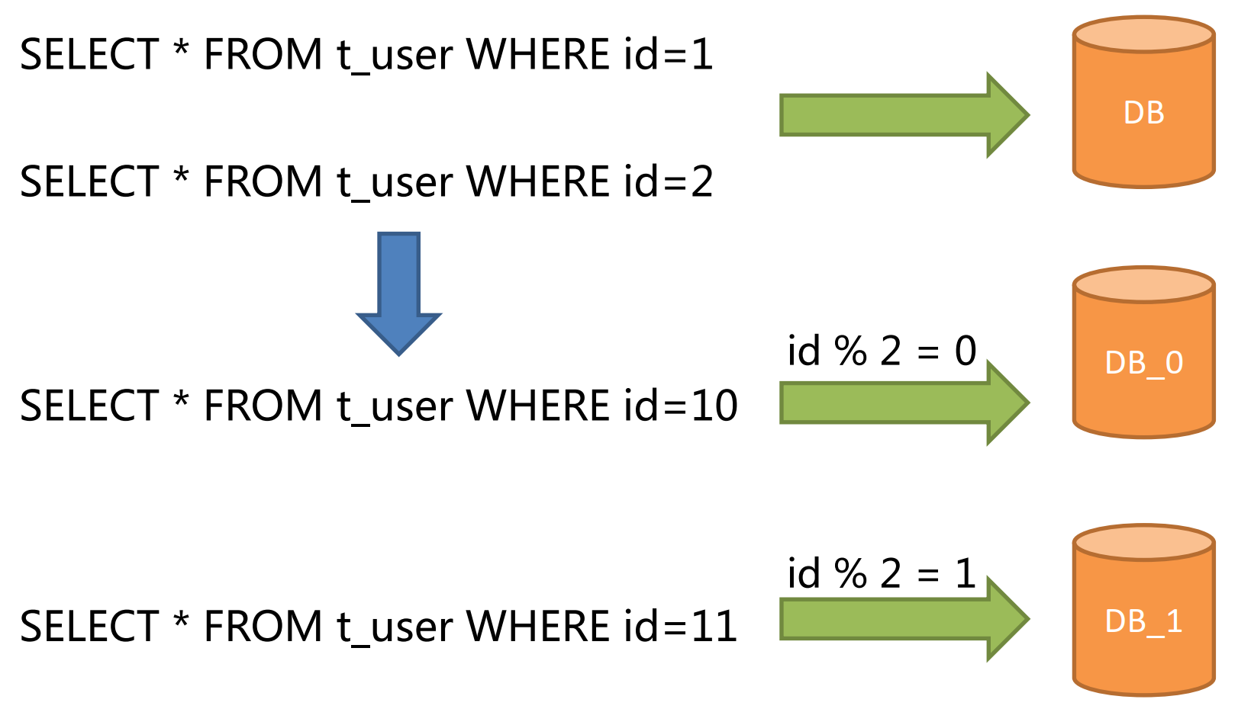
Features - Data sharding
Horizontal Sharding

Slide 14
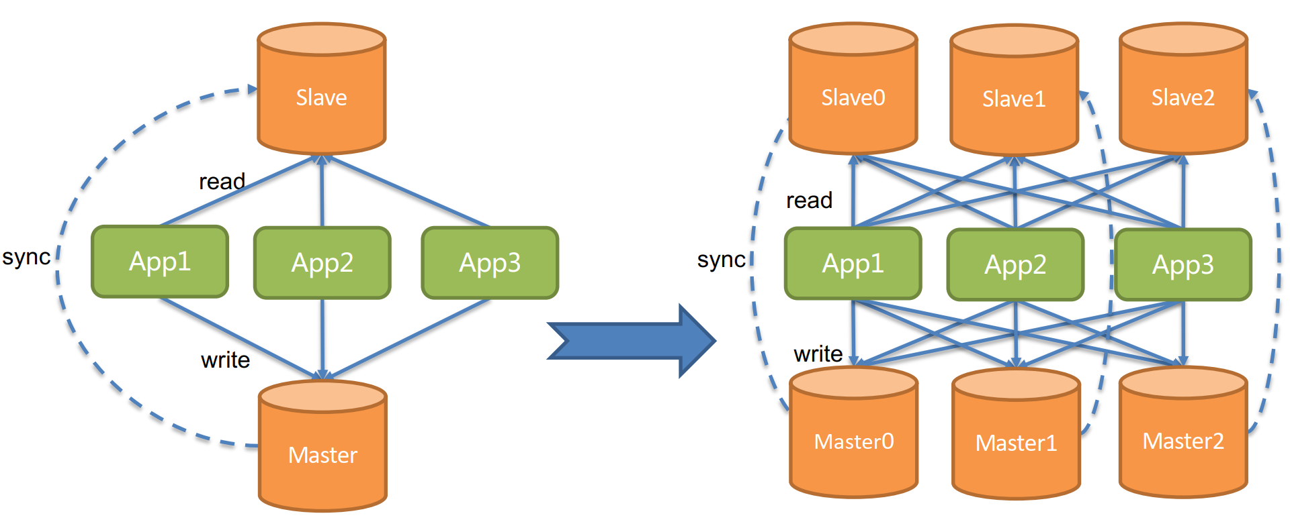
Features - Data sharding
Data Sharding & Readwrite-splitting

Slide 15
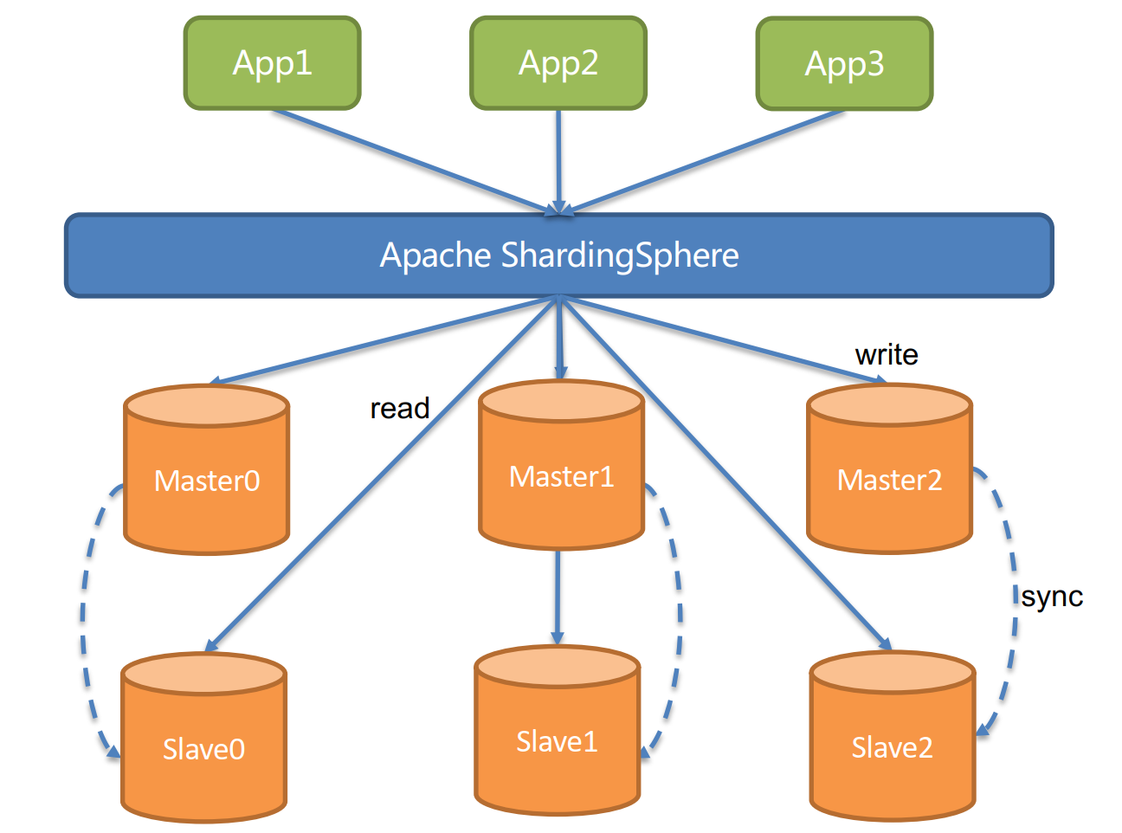
Features - Data sharding
Integrate ShardingSphere

Slide 16
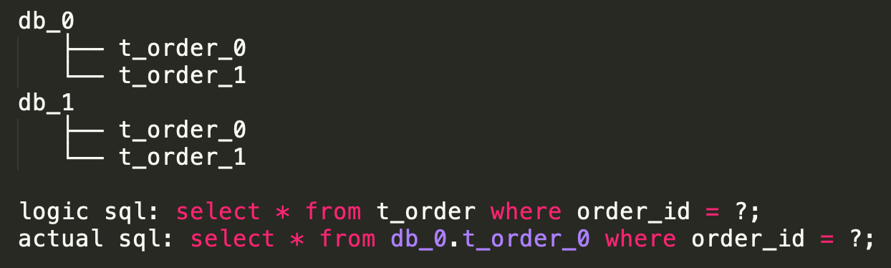
Features - Data sharding
Execute SQL transparently: oriented to logical SQL operations
Customized Sharding Algorithm
Java Class: xxx.xxx. XXXShardingAlgorithm
Inline Expression: t_order_$->{order_id % 2}
Built-in algorithm: hash, range, time
Built-in distributed ID generator
UUID
SNOWFLAKE

Slide 17
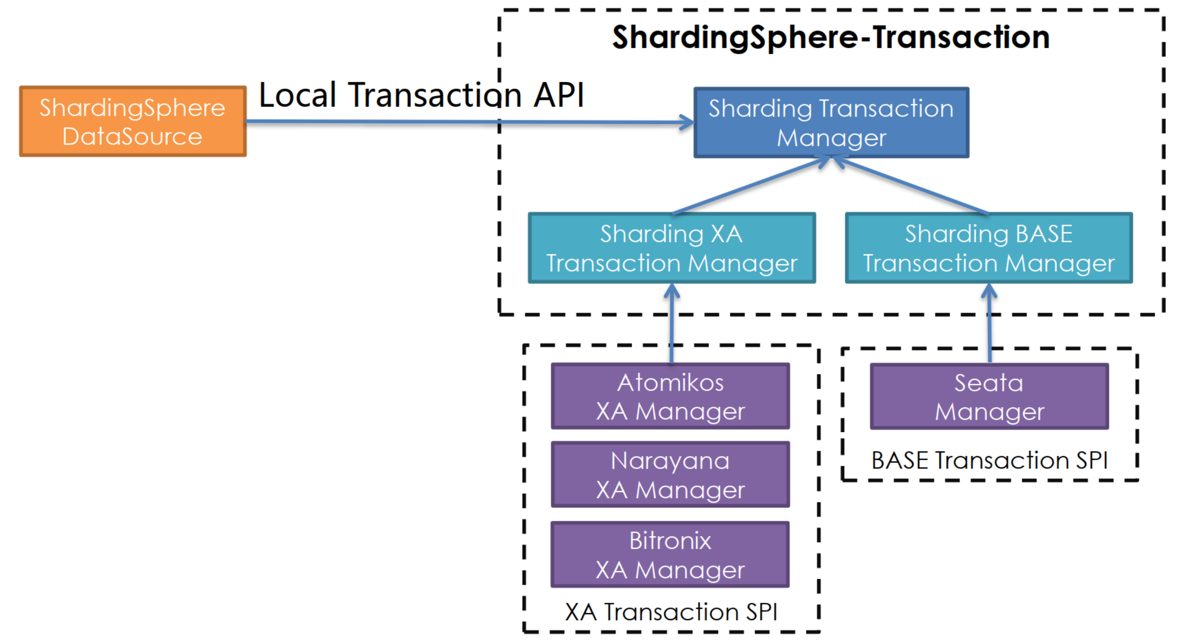
Features - Distributed transaction
Notes:
通过统一的事务API，集成了XA事务和BASE事务，降低了用户使用成本。

Slide 18
Features - Distributed transaction
 | Local transaction | 2PC (3PC) transaction | BASE transaction
Business transformation | None | None | Relevant interface
Consistency | Not support | Support | Eventual consistency
Isolation | Not support | Support | Business-side guarantee
Concurrency performance | No influence | Serious recession | Minor recession
Situation | Inconsistent operation at business side | Short transaction & low concurrency | Long transaction & high concurrency
Notes:
通过统一的事务API，集成了XA事务和BASE事务，降低了用户使用成本。

Slide 19
Features - Database Governance
Dynamic Configuration
Highly Available
Circuit Breaker
Authority & Data Encryption & SQL Audit
APM & Application Topography & Monitor Notification

Slide 20
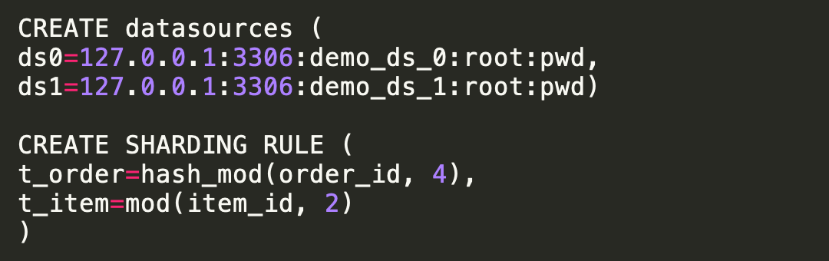
Features - New Features
Dist SQL (Distributed SQL): design to break the boundary between middleware and database
RDL（Resource & Rule Definition Language）
RQL（Resource & Rule Query Language）
SCTL（ShardingSphere Control Language）
Data Scaling (Dev): common solution for migrating or scaling data

Slide 21
Community
04
社区

Slide 22
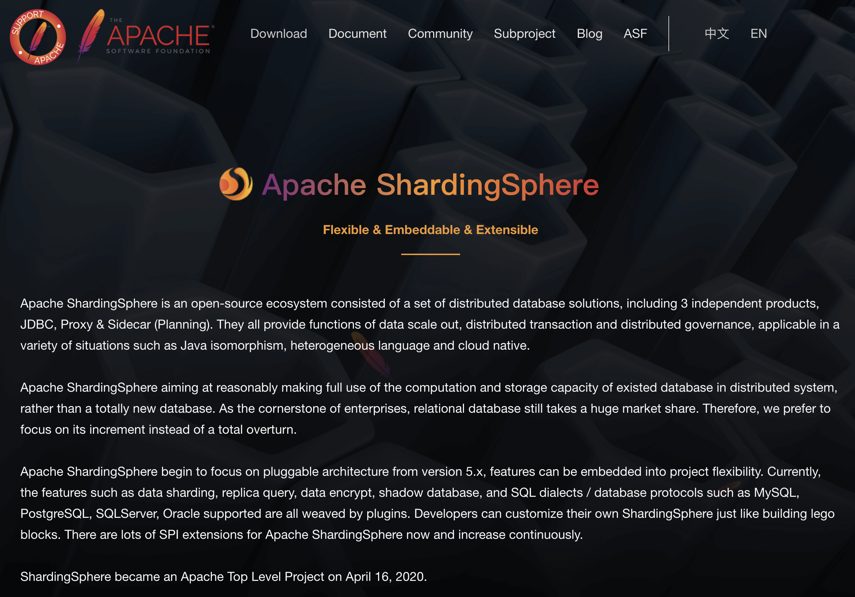
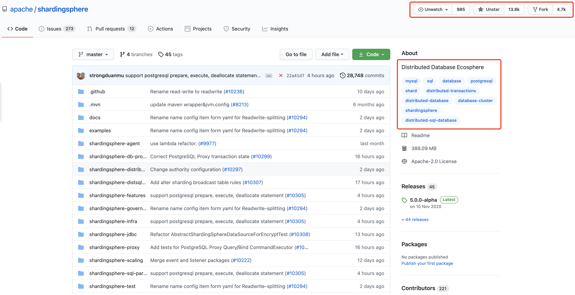
Community
Website: https://shardingsphere.apache.org
GitHub: https://github.com/apache/shardingsphere

Slide 23

Community
https://shardingsphere.apache.org/community/en/powered-by/

Slide 24


Welcome on board
https://shardingsphere.apache.org/
https://github.com/apache/shardingsphere
mailto:dev-subscribe@shardingsphere.apache.org
wechat group

Slide 25
THANKS

